Slide 1

Credit Card Customer Report

Slide 2

Key Metrics
Total Revenue: ₹57,517,011
Total Interest: ₹8,040,480
Total Income: ₹588,320,192
Customer Satisfaction: 3.2

Slide 3

Revenue By Week
A line graph showing the sum of revenue from January 2023 to October 2023, with two lines representing different data series.

Slide 4
Revenue by Job Basis
Businessman:
₹9M, ₹9M
Govt:
Blue-collar:
₹5M
₹3M, ₹4M
Self-employed:
₹5M, ₹3M
Retirees:
White-collar:
₹7M
₹3M

Slide 5
Revenue by Education
Graduate:
₹10M, ₹13M
High School:
₹5M, ₹6M
Unknown:
₹4M, ₹4M
Uneducated:
₹5M
Post-Graduate:
₹5M
Doctorate:
₹4M

Slide 6

Revenue By Age
20-30: ₹4M, ₹6M
30-40: ₹11M, ₹14M
40-50: ₹11M
50-60: ₹9M, ₹10M
60+: ₹1M

Slide 7

Revenue by Marital Status Married: ₹13M, ₹16M Single: ₹11M, ₹13M Unknown: ₹1M

Slide 8
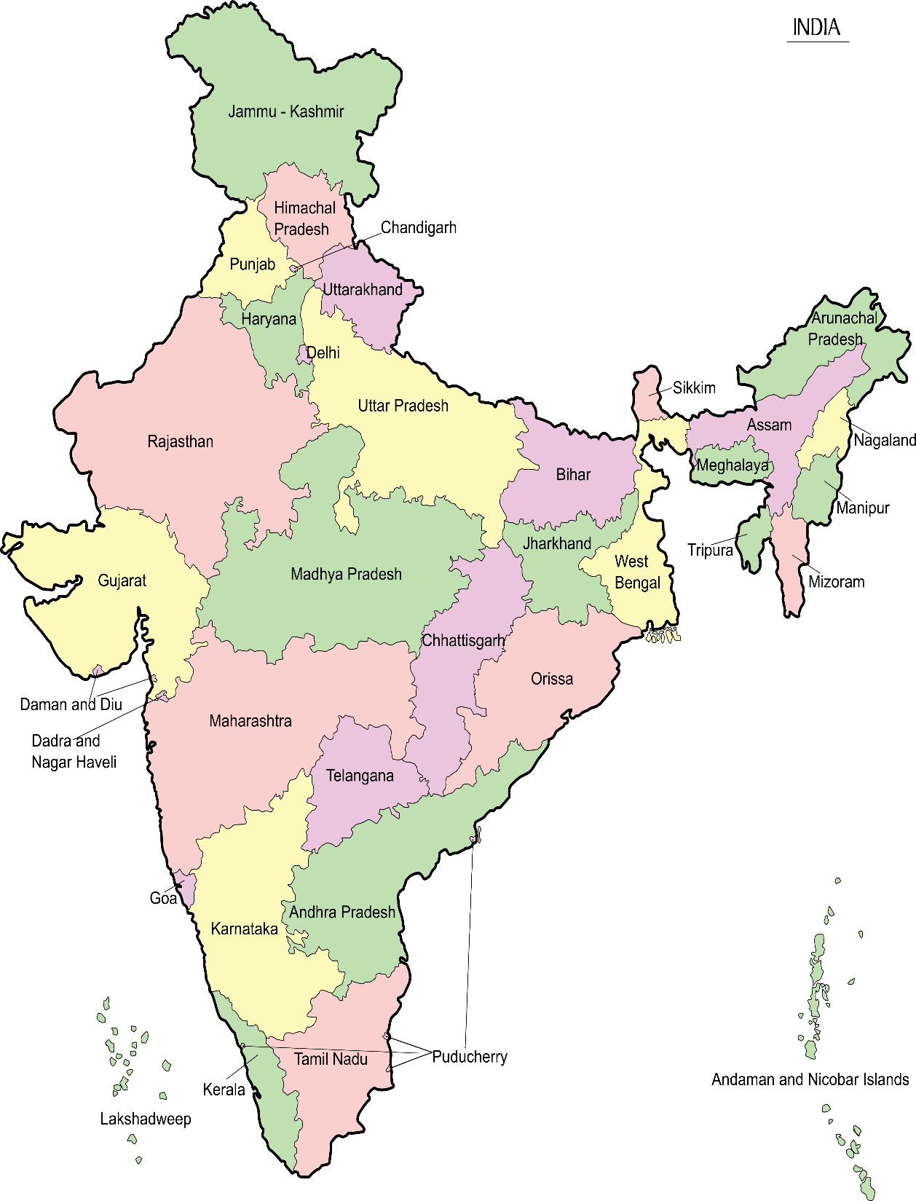
Revenue By Top 5 State
20-30: ₹4M, ₹6M
30-40: ₹11M, ₹14M
40-50: ₹11M
50-60: ₹9M, ₹10M
60+: ₹1M
This Photo by Unknown Author is licensed under CC BY-SA

Slide 9

Revenue By Income Group
High: ₹7M, ₹23M
Med: ₹10M, ₹8M
Low: ₹8M

Slide 10

Conclusion
The dashboard also includes filters for different quarters (Q1, Q2, Q3, Q4), card types (Gold, Silver, Blue, Platinum), and transaction types (Swipe, Online, Chip). There is also a dropdown for selecting the week start date.

